Slide 1

FLEETCOIN
An immutable logbook to protect your fleet
SEDA aydinoglu, Jo BORRAS, TAPAS ROY, AYUSH SHAH

Slide 2
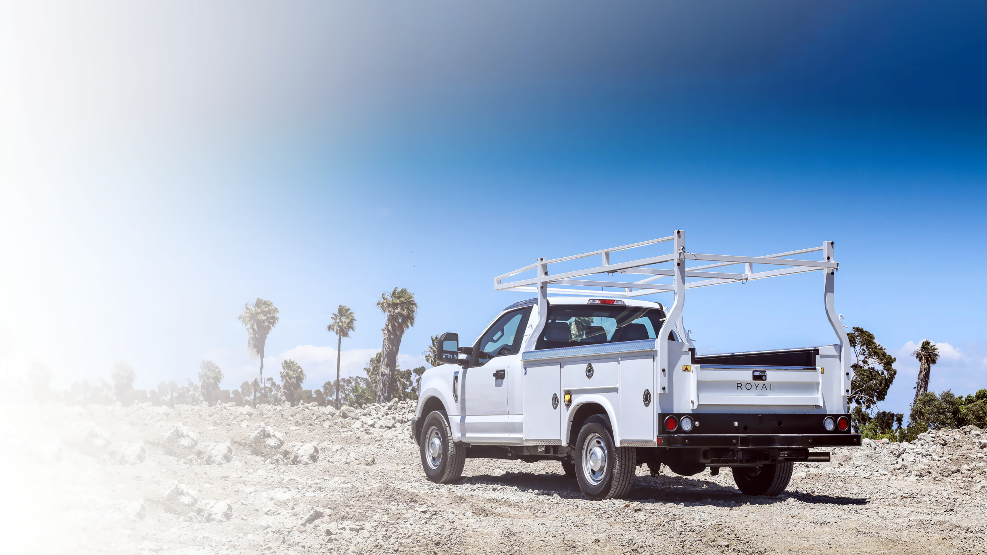
FLEETCOIN | OUTLINE
Introduction to FLEETCOIN
four different personas
HOW FLEETcoin works
REWARDING users
TRADEABLE NFTS

Slide 3
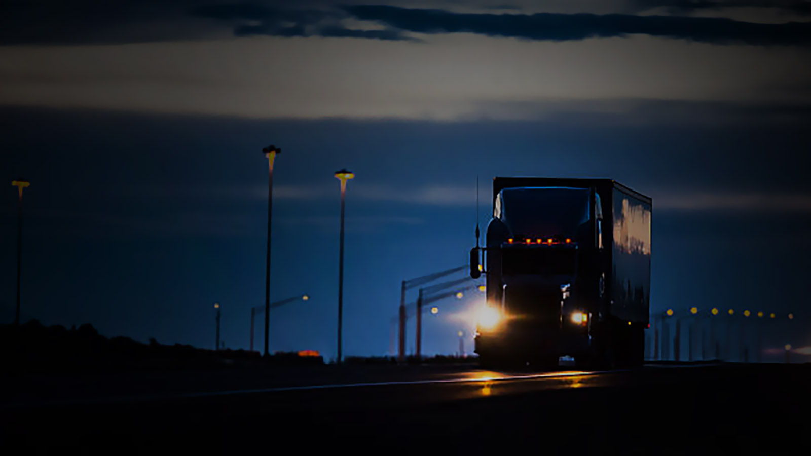
FLEETCOIN | INTRODUCTION
fleetcoin puts the true, complete history of your vehicle on the blockchain, creating a certified, unchangeable record of purchase, operation, maintenance, and repair to keep your business secure.
In this presentation, we’ll discuss how fleetcoin can serve the needs of four very different PEOPLE, and protect the legal interests of the owners and operators who keep america truckin’.

Slide 4

FLEETCOIN | MEET RODNEY
RODNEY USED TO DRIVE A TRUCK, HIMSELF. BUT RODNEY WAS SMARTER THAN MOST. HE WORKED HARD, SAVED money, AND NOW OWNS A FLEET OF TRUCKS.
Instead of worrying about money these days, Rodney loses sleep over his drivers staying compliant, keeping his trucks in tip-top shape, and keeping them on the road as much as possible.

Slide 5

FLEETCOIN | FOR RODNEY
GOALS
Rodney wants to make sure his drivers are staying compliant, taking their brakes when they’re supposed to and staying fresh – and safe! – on the road.
Rodney wants to stay on top of his fleet’s maintenance needs, minimizing downtime and maximizing time on the road – and on the clock!
GOALS MET
Fleetcoin creates a complete log of operator trips, with a digital timestamp that can’t be altered or entered incorrectly.
With fleetcoin, rodney will be able to quickly and easily monitor his fleet’s use, recommended service dates, and more – making scheduling “downtime” much easier and avoiding suprises.
rodney worries about
Rodney worries about his drivers changing their log books after the fact. Maybe they mean well are trying to help out, but they’re doing more harm than good by falsifying records, and that could get Rodney’s company in hot water later.
When a truck is down for service, it’s not making money. Rodney can plan for regular maintenance, but if something slips through the cracks it can cause big headaches down the road.
rodney feels good about
Fleetcoin uses blockchain technology to ensure that each entry is permanent and unchangeable. If Rodney’s company were ever to be accused of falsifying records, he’d have hundreds of validators defending his drivers’ log.
When an operator reports an issue or declines liability, fleetcoin triggers a message to Rodney right away, alerting him that there might be an issue with his equipment. If they catch it early, it will be cheaper (and quicker!) to fix.

Slide 6

FLEETCOIN | MEET TOM
Tom loves his family, even if he’s always been a bit of a “black sheep”. He loves his job, too, and takes pride in being an “old skool trucker” who takes his job seriously. What’s more, tom is good at his job. if tom tells you a delivery will be there by 3:00pm, you can set your watch by it.
Even so, tom’s getting older, and he’s starting to worry about his health from those long hours spent in the cab. He doesn’t know what he’d do if he lost his job and his insurance.

Slide 7
FLEETCOIN | FOR TOM
GOALS
Tom wants to Keep a complete log of his trips so he can show that he’s still up for the job and ensure that he maintain compliance
Tom wants to stay employed (and on the company insurance) until he decides it’s time for him to move on, and not before.
GOALS MET
Fleetcoin creates a complete log of operator trips, with a digital timestamp that can’t be altered or entered incorrectly.
With fleetcoin, tom’s excellent work record will be “etched in stone”, and validated by hundreds of validators.
Tom worries about
Tom is happy to call himself an “old skool trucker”, but worried about the company using hand written log books that just get handed in to dispatch when he rolls into h.q.. what would happen if one of those cards got thrown away entered into the system incorrectly?
Tom takes pride in his job, but these young guys? He’s not so sure about them. Come to think of it, he’s not too sure about his managers, either. He thinks they’re “bean counters” who cut corners. How can he make sure he doesn’t have to hit the road in a truck with bald tires or a bad taillight and risk getting in trouble?
Tom feels good about
With fleetcoin, there are no hand-written cards to lose and no one else to leave responsible for tom’s miles and hours. Tom believes, “if you want something done right, do it yourself,” and fleetcoin’s easy to use front-end makes “doing it yourself” a breeze for guys like tom.
Fleetcoin has a built-in “assumption of liability” contract that will enable tom to reject a truck that doesn’t meet safety standards. When that happens, a permanent record of his objection is created and the problem will have to be resolved, or liability assumed buy someone else, before tom hits the road.

Slide 8

FLEETCOIN | MEET MARC
Marc has an important job, and he knows it. He keeps America’s truckers on the road, and keeps the economy humming along.
After nearly thirty years in the business, Marc operates under the motto of “cya”, and performs a thorough inspection on every truck that rolls into his shop.

Slide 9
FLEETCOIN | FOR MARC
GOALS
marc wants a permanent record of all his service recommendations, so that no one can say he “missed something”.
Marc does a full safety inspection on every truck that rolls into his shop, and wants to make sure there’s a record of that inspection, even if the owner doesn’t follow his recommendations.
GOALS MET
Fleetcoin creates a complete log of service visits, and allows service technicians to record their notes into the blockchain.
With fleetcoin, tom’s excellent work record will be “etched in stone”, and validated by hundreds of validators.
marc worries about
marc worries about everything. He worries about opening himself up to liability, sure, but he also genuinely worries about the safety and well-being of his customers. If they go to another shop (which is bound to happen with over-the-road truck fleets), marc wants to be sure his customers have everything they need to ensure that they can get back on the road quickly and safely.
MARC feels good about
With fleetcoin, all of a vehicle’s service history is stored on the blockchain, making it easy for owners, fleet managers, and other technicians to access those records, no matter where they are.

Slide 10

FLEETCOIN | MEET JULIE
Julie’s clients don’t stop suffering at 5pm, so she doesn’t feel like she should stop working at 5pm. She burns the midnight oil to make sure that justice is served, and she’ll do everything she can to bring the truth to light.
Other lawyers say, “you don’t want to go up against julie in court,” for a reason.

Slide 11
FLEETCOIN | FOR JULIE
GOALS
julie wants justice for her clients – regardless of who she’s representing in court on any given day.
GOALS MET
When Julie is representing the owner of a fleet against a mult-million dollar accident claim, she’ll appreciate having a complete, authenticated service record.
julie worries about
julie worries about surprises when she’s defending fleet owners, and that means having access to complete records. If something’s missing or out of place, she needs to know immediately.
When she’s representing individuals who are going against fleet owners, Julie worries about logbooks changing after the fact to favor the defendant.
julie feels good about
Fleetcoin offers defense attorneys a complete database of searchable log entries and service records. If there are missing dates or files or a service item drops off the notes, she’ll be able to see that immediately and modify her defense.
With fleetcoin, there are no hand-written cards to white-out, change, or conveniently “lose” behind a desk before a deposition.

Slide 12

FLEETCOIN | HOW IT WORKS
FLEETcoin is an account based ledger that is specifically tailored to needs of managed fleets. each account is tethered to the vehicle’s identification number, or vin. the first record entered in the ledger is the account’s activation. from there, a log entry is completed every time an operator begins or ends a trip.
Owners who keep more complete records benefit from reduced liability exposure and additional trux – the governance token that powers fleetcoin – which can be exchanged for cash or collectible nfts.

Slide 13
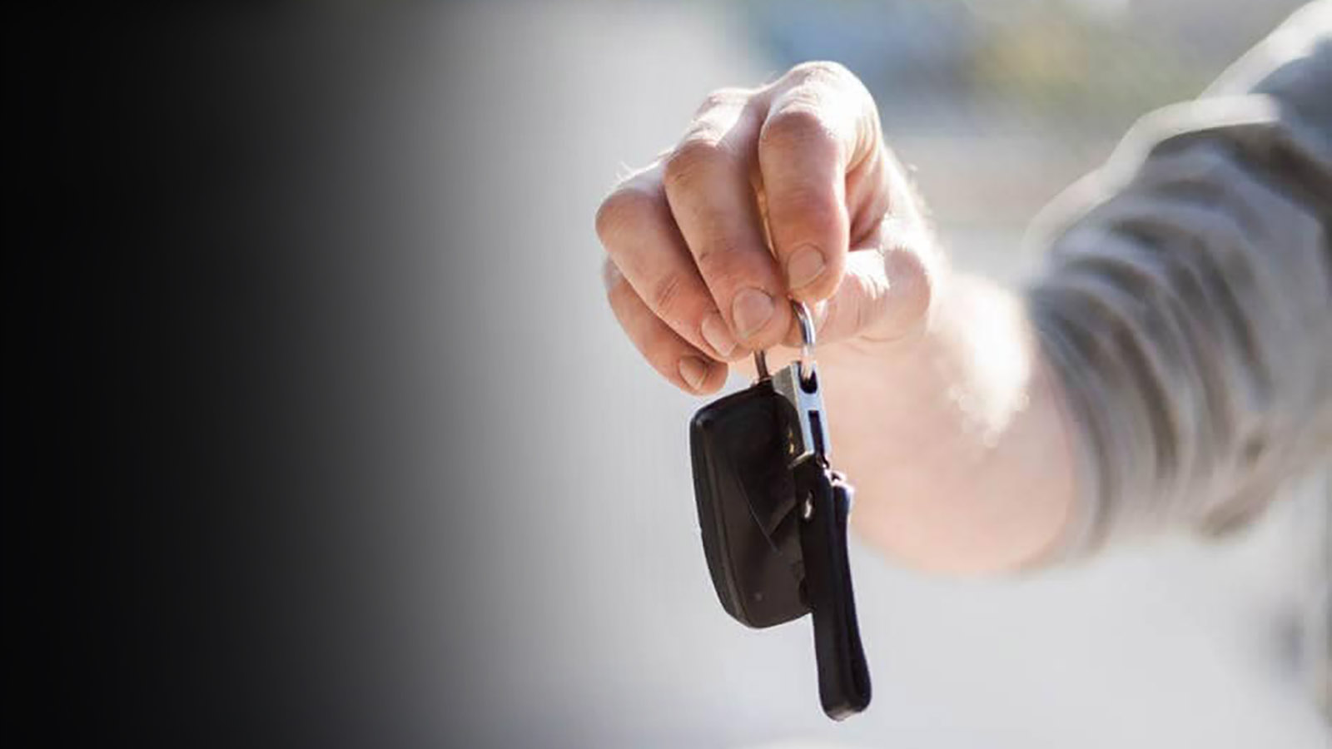
FLEETCOIN | CHAIN OF CUSTODY
FLEETCOIN OFFERS FLEET MANAGERS ALL THE BENEFITS OF AN IMMUTABLE, VERIFIED LEDGER – BUT THE REAL POWER OF FLEETCOIN IS THE CHAIN OF CUSTODY FUNCTION WHICH IS BUILT INTO THE NATURE OF THE BLOCKCHAIN.
EVERY TIME AN OPERATOR OR TECHNICIAN LOGS AN EVENT, THEY ENTER INTO A “SMART CONTRACT” TO ACCEPT LIABILITY FOR THE VEHICLE AS IT IS AT THE TIME OF THE ENTRY – AND THEY MUST ACCEPT LIABILITY BEFORE THEY SET OFF WITH THE VEHICLE.
WITH FLEETCOIN, THE QUESTION OF WHO IS LIABLE IS ANSWERED AT EVERY STEP.

Slide 14
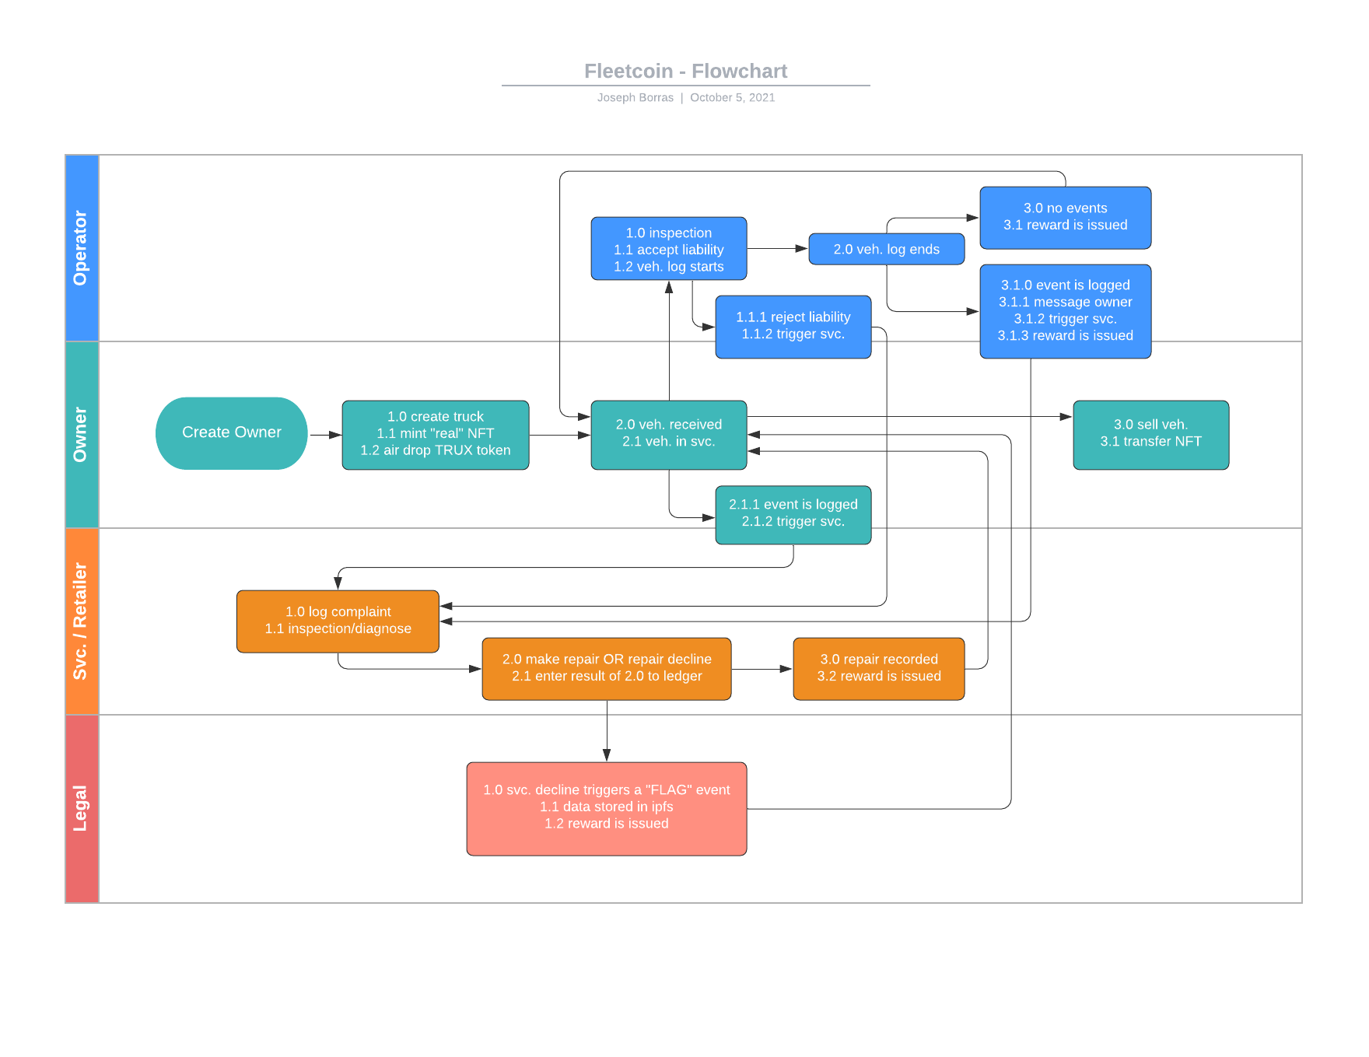
FLEETCOIN | THE LOGIC (1:3)
ONCE A VEHICLE IS ENTERED INTO AN OWNER’S FLEET (DICTIONARY), AN NFT IS MINTED CONTAINING THE VEHICLE’S VIN AND MILES AT THE TIME OF ACTIVATION.
ONCE THE VEHICLE IS IN SERVICE, THE OPERATOR MUST COMPLETE A LIABILITY CONTRACT IN ORDER TO ENTER AN EVENT AND TAKE THE VEHICLE.
ANOTHER EVENT IS ENTERED WHEN THE VEHICLE IS RETURNED OR ARRIVES AT ITS NEXT STOP OR FINAL DESTINATION.

Slide 15
FLEETCOIN | THE LOGIC (2:3)
IF NO EVENT IS RECORDED (MILES IN, MILES OUT, NO NOTES), THE VEHICLE IS ENTERED BACK INTO SERVICE.
IF AN OPERATOR DECLINES THE LIABILITY CONTRACT AT ANY POINT, FLEETCOIN WILL ALERT THE OWNER AND TRIGGER A SERVICE OR SAFETY INSPECTION.
THE RESULTS OF THAT INSPECTION AND ANY ASSOCIATED NOTES ARE ENTERED INTO THE RECORD.

Slide 16
FLEETCOIN | THE LOGIC (3:3)
IN THE EVENT OF AN INCIDENT, ANY PARTY INTERESTED IN VIEWING THE COMPLETE, VALIDATED RECORD OF THE VEHICLE WILL BE ABLE TO ACCESS IT WITH THE OWNER ADDRESS.
OWNERS HAVE A COMPLETE CHAIN OF CUSTODY RECORD OF THAT “LIABILITY” BATON.
OWNERS AND OPERATORS ARE INCENTIVIZED TO RECORD ENTRIES WITH TRUX – THE GOVERNANCE TOKEN THAT POWERS FLEETCOIN – WHICH THEY CAN EXCHANGE FOR OTHER CRYPTO, CASH, OR TRADE FOR COLLECTIBLE NFTS.

Slide 17
FLEETCOIN | MINIMUM VIABLE PRODUCT (MVP)
SUPPORTS FOLLOWING FEATURES:
VEHICLE REGISTRATION AS NFT
LOGBOOK ENTRY
SERVICE DETAILS ENTRY
VIEW VEHICLE RECORDS
MVP COMPONENTS:
SOLIDITY SMART CONTRACT – backend logic
.SOL AND .JSON
IPFS – backend storage
PYTHON NOTEBOOK – user touchpoints
.ENV FILE WITH:
PINATA_API_KEY & PINATA_SECRET_API_KEY
WEB3_PROVIDER_URI
SMART_CONTRACT_ADDRESS

Slide 18
FLEETCOIN | MVP VIEW VEH. RECORDS
BACKENDS
USER TOUCHPOINT (PYTHON)
USERS
VIN, DMV REGISTRATION DATE AND MILEAGE
PYTHON CONVERTS TO JSON AND SAVE IN IPFS
PYTHON CALLS SMARTCONTRACT FUNCTION TO REGISTER AS NFT
PYTHON RETURNS TOKEN_ID TO USER AND INFORMS HIM ABOUT HIS REWARD TOKENS
Owner
PROVIDES
{'vin': '1FMZK04185GA30815',
'registration_date': '10/04/2020',
'mileage': '2000'}
IPFS API CALL
IPFS
TOKEN_ID
IPFS CO-ORDINATE (URI)
registerVehicle(owner addr, vin, ipfs uri) {
(1) mint nft
(2) map token_id to vehicle_object
(3) map token_id to IPFS_URI (1:1)
(4) reward user with utility tokens }
.SOL FUNCTION CALL
RETURNS TOKEN_ID
SMART CONTRACT

Slide 19
FLEETCOIN | MVP LOGBOOK + SVC. ENTRY
BACKENDS
USER TOUCHPOINT (PYTHON)
USERS
TOKEN_ID AND LOGBOOK INFO
PYTHON CONVERTS TO JSON AND SAVE IN IPFS
PYTHON CALLS SMARTCONTRACT FUNCTION TO REGISTER LOG
PYTHON INFORMS USER ABOUT HIS REWARD TOKENS
OPERATOR &
SERVICER
PROVIDES
{'start_or_end': 'start',
'logtime': '2021-10-07 21:40:24',
'operator_name': 'Tapas Roy',
'mileage': '2500',
'safety_OK?': 'Y'}
IPFS API CALL
IPFS
IPFS CO-ORDINATE (URI)
registerLog(token_id, ipfs uri) {
(1) mint nft
(2) update on-chain vehicle object
(3) map token_id to IFPS Log_URI (1:n)
(3) emit state change event
(4) reward user with utility tokens }
CONTRACT FUNCTION CALL
SMART CONTRACT
NOTE: THERE IS A SIMILAR WORKFLOW FOR BOTH LOGBOOK AND SERVICE DETAILS ENTRY

Slide 20
FLEETCOIN | MVP N MAPPING FOR LOGS + SVC. ENTRY
struct logURIStruct {
string IPFS_URI;
}
mapping(uint => logURIStruct[]) logHistory;
Mapping(token_id => string[]) public vehicle history
string is an array of bytes and string[] is a 2-d array - not supported by solidity
However, solidity supports array of structs driving the solution on right
logURIStruct {URI-1}
logURIStruct {URI-1}
logURIStruct {URI-1}
logURIStruct {URI-1}
logURIStruct {URI-1}
……..
Token_id = 1
Solidity can’t create getter and setter for array of struct – hence public modifier is not allowed
That means getter and setter have to be implemented

Slide 21
FLEETCOIN | MVP LOGBOOK + SVC. ENTRY
BACKENDS
USER TOUCHPOINT (PYTHON)
USERS
(1) getVehicleURI(token_id) from the mapping
(2) getLogURIs(token_id) from respective mapping
(3) getServiceURIs(token_id) from respective mapping
(4) Returns all URIs to python
TOKEN_ID
PYTHON CALLS SMART CONTRACT GET FUNCTIONs OF MAPPINGs
FOR EACH RETURNED URI PYTHON RETRIEVES JSON CONTENT FROM IPFS
PYTHON DISPLAYES ALL VEHICLE RECORDS TO USER
PROVIDES
LEGAL &
OWNER
SMART CONTRACT
SMART-CONTRACT CALL
ALL IPFS URIs
TOKEN_ID
VEHICLE JSON
{'vin': '1FMZK04185GA30815',
'registration_date': '10/04/2020',
'mileage': '2000’}
LOGBOOK JSON
{'start_or_end': 'start',
'logtime': '2021-10-07 21:40:24',
'operator_name': 'Tapas Roy',
'mileage': '2500',
'safety_OK?': 'Y’}
{ service json }
CALLS IPFS GET API
RETURNS JSONs
IPFS

Slide 22
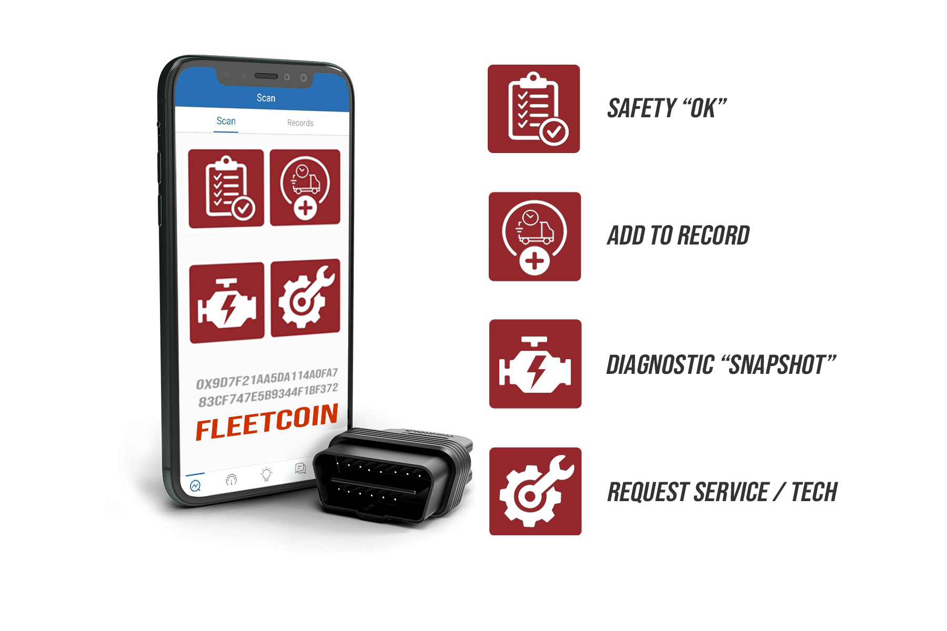
FLEETCOIN | IN PRACTICE (1:7)
The ledger is accessed through an android or ios app, which serves as a wallet to verify the operator’s id.
A Bluetooth connected obd dongle communicates with both the phone and the vehicle to record vehicle data and apply timestamps, which are then passed to the blockchain through the phone’s data connection.

Slide 23
FLEETCOIN | IN PRACTICE (2:7)
The first step for the operator is the “safety ok” entry. By selecting “safety ok”, the operator is stating they’ve checked the vehicle and accept liability.
Logic is built into the app and dongle that prevents the vehicle from starting unless “safety ok” is selected.

Slide 24
FLEETCOIN | IN PRACTICE (3:7)
If the operator chooses to decline liability, their only option is “request service”, which takes the vehicle out of service until a technician (using their own wallet/id) accepts liability.

Slide 25
FLEETCOIN | IN PRACTICE (4:7)
if “safety ok” is selected and the operator accepts liability, a “diagnostic snapshot” of the vehicle is taken.
This records the timestamp, miles, fuel level, and other diagnostic data (such as check engine or other warning lights) and enters them into the ledger.

Slide 26
FLEETCOIN | IN PRACTICE (5:7)
Once the job/trip is over, the operator must add it to the record.
Logic is built into the app and dongle that prevents the vehicle from shutting off unless the trip is added to the record.

Slide 27
FLEETCOIN | IN PRACTICE (6:7)
Once the job/trip is over, the operator must add it to the record.
Logic is built into the app and dongle that prevents the vehicle from shutting off unless the trip is added to the record.
on the first click, the operator is prompted to enter any relevant notes they want added into the ledger, or request service.

Slide 28
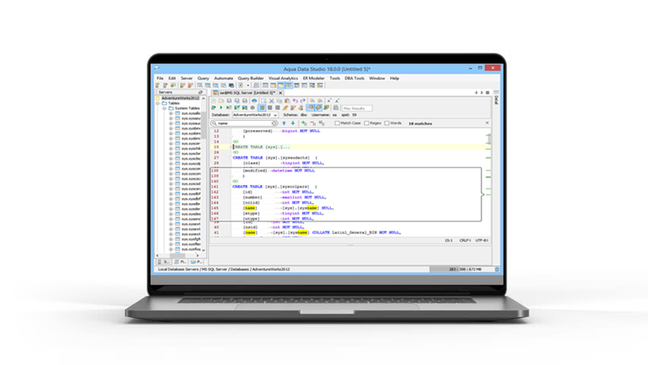
FLEETCOIN | IN PRACTICE (7:7)
All the entries, along with their associated notes, are stored on the uri and exportable as a database, which can be imported into existing fms or sms systems, or even quickbooks, in the case of a small business fleet.
Attorneys may also access the fleet’s complete, verified data records as needed to support their case in court.

Slide 29

FLEETCOIN | TRUX REWARDS
Trux is the utility and governance token of fleetcoin. Trux are minted whenever a vehicle is registered and a new nft is minted.
Trux are given as rewards to owners, operators, and servicers who interact with the fleetcoin blockchain and acts as another incentive to keep a complete, verified record.
Eventually, Trux can be exchanged for other crypto, cash, or used to purchase collectible nfts on the fleetcoin exchange (next slide).

Slide 30

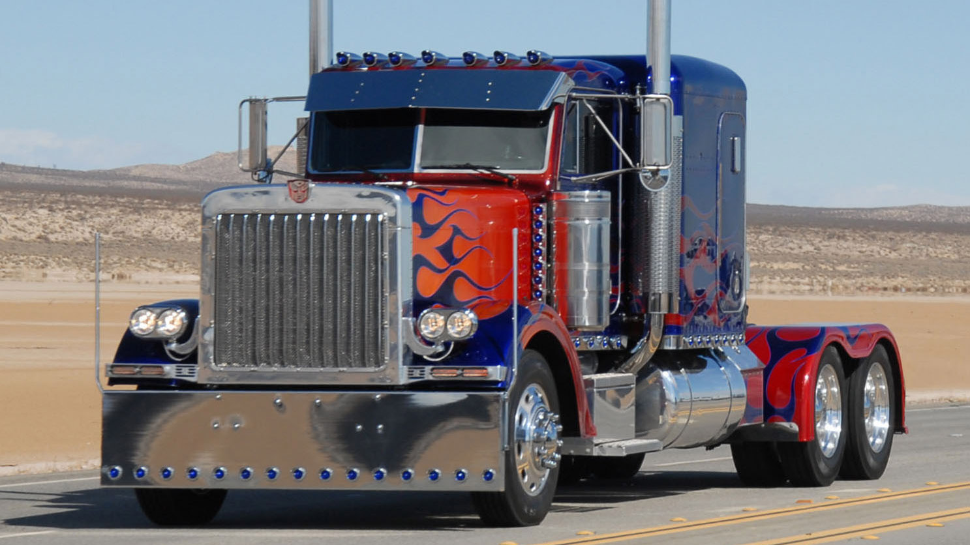

FLEETCOIN | COLLECTIBLE NFTS
Whether it’s the truck from mad max fury road or optimus prime from the transformers that first ignited your love of trucks, fleetcoin’s unique collection of nfts based on the most iconic fictional vehicles of all time is sure to have one – or several – trucks that you can call your own.
Buy them, sell them, or trade them – the choice is yours, and it’s all managed with the power of Ethereum smart contracts.
These collectible nfts can be obtained from air drops as a reward for creating log events, or through initial sales/auctions.
NOTE: captain chaos’ cannonball run transcon medi-vac ambulance is not for sale!

